Slide 1


StackPals
Focus & Wellness Independent Desktop Companion
ENT208TC | Group 24 | Demo Day

Slide 2

The Distraction Crisis
Hyper-Focus Neglect
The Smartphone Paradox
When in "the zone," students and workers lose track of time entirely, leading to muscle strain, eye fatigue, and severe mental exhaustion.
Using a phone for a timer often backfires. A single notification leads to endless scrolling, destroying the very focus the user intended to save--The device we use to help us focus is actually our biggest source of distraction.

Slide 3
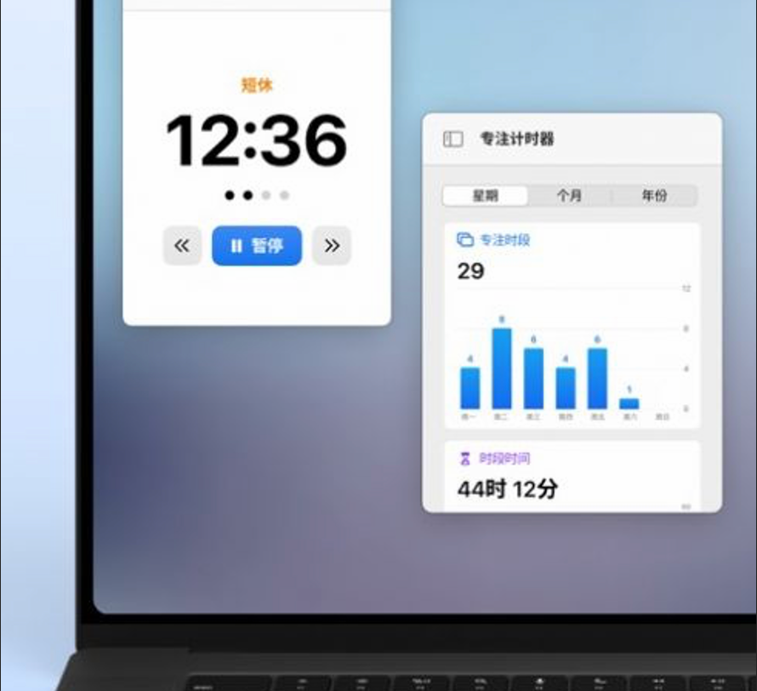
Invisible Software
Why Apps Fail
•
Easy to Ignore: Background alerts are swiped away without thought during intense work sessions.
•
Lack of Presence: Digital pop-ups don't create an emotional or tactile connection with the user.
•
Screen Fatigue: Adding more notifications to an already crowded screen increases cognitive load.

Slide 4
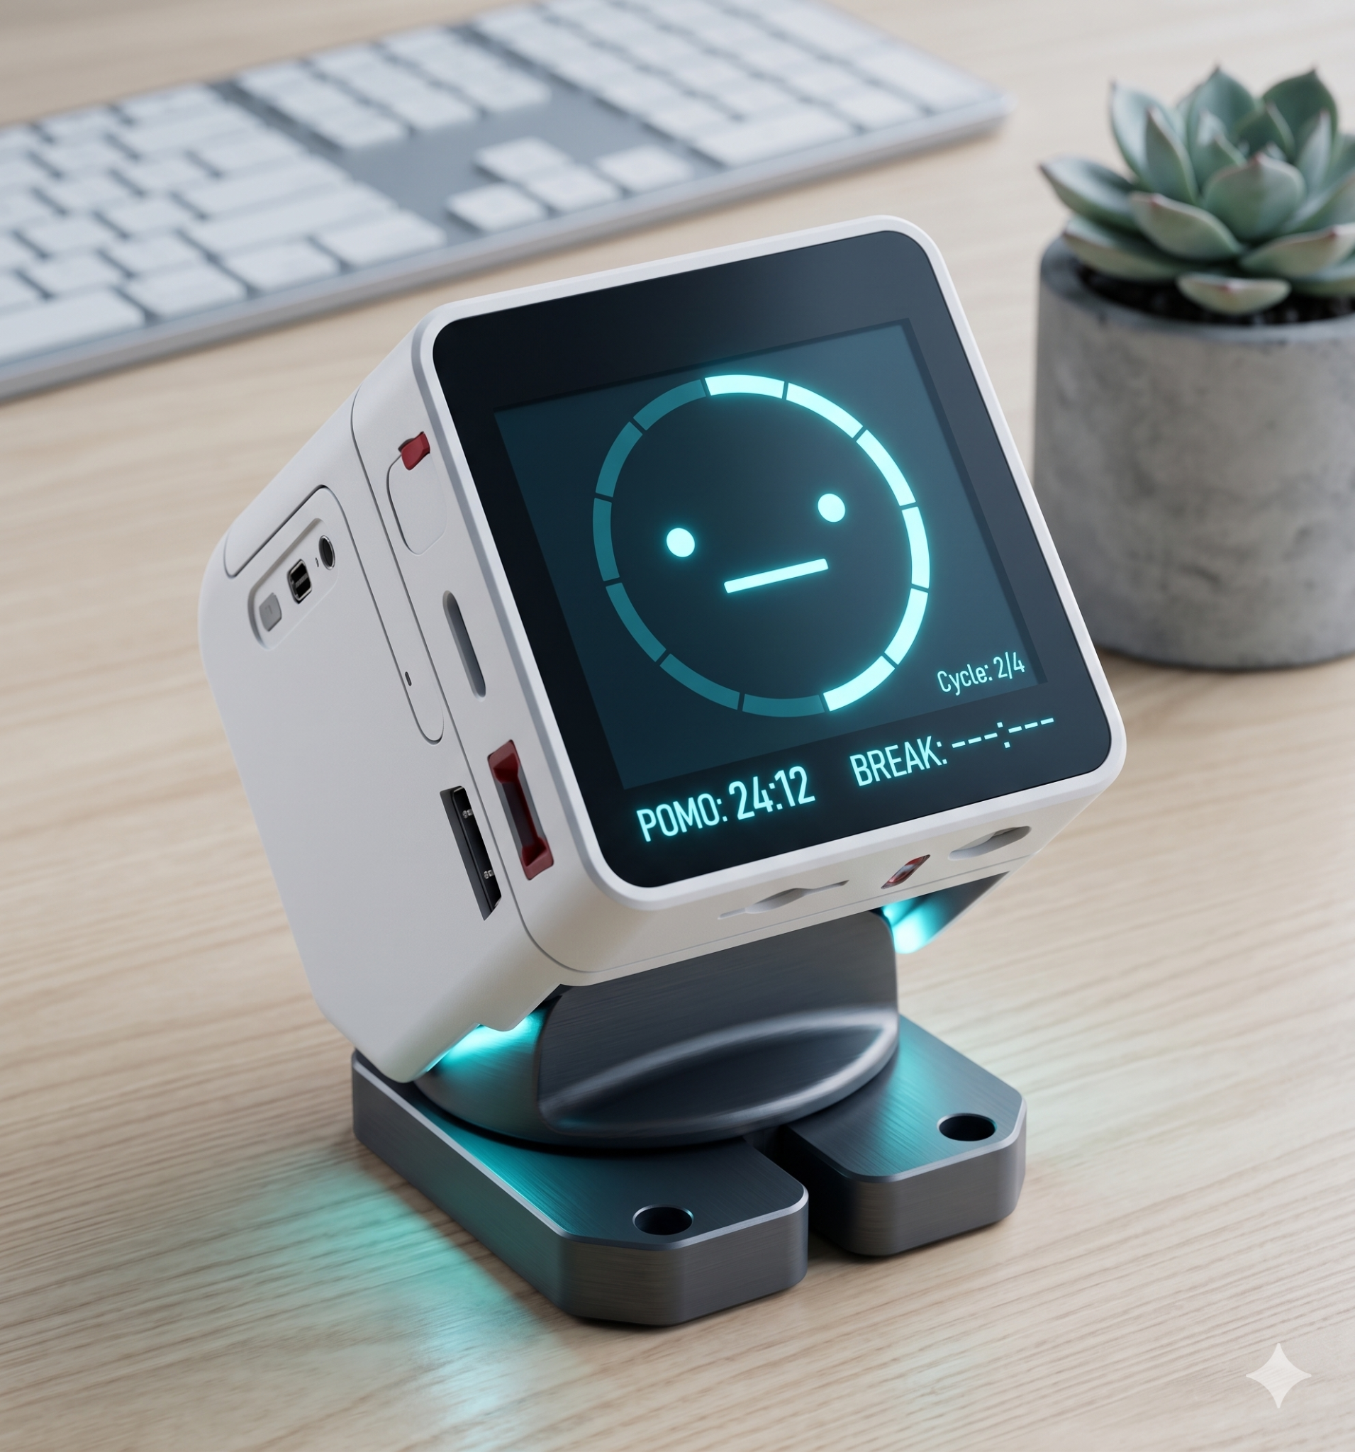
Independent Hardware
Tangible & Dedicated
StackPals is a standalone physical device. It lives on your desk, strictly for focus. No social media, no distractions—just a dedicated wellness partner.
Equipped with an intuitive interface and conversational intelligence.

Slide 5






The 3-Button Architecture
Left Button
Middle Button
Right Button
Timer Control. Start, pause, or end your countdown sessions with a single physical click.
Visual Data. Instantly view focus history, streaks, and productivity analytics on screen.
Settings. Customize timers, choose ringtones, or swap "Desk Pet" skins.

Slide 6
LIVE DEMO
Witness the "Desk Pet" Ecosystem in Action

Slide 7
User Validation Results
92%
4/5
85%
BUTTON INTUITION
DAILY ADOPTION
VOICE ACCURACY
Requiring Zero Instruction Manual
"Pressing that physical left button feels like a ritual. It completely kills my urge to grab my phone" — Tester User
Creates a physical boundary against digital distractions

Slide 8
Scale & Refinement
Less Noise, More Soul
Escape the Phone, Enter the Zone
The clear roadmap for StackPals
Hardware
Voice AI
Connectivity
Launch
Refine the hardware experience, improving the tactile feedback of the three buttons and upgrading the screen display
Deepening NLP for emotional support dialogs.
Offer personalized voice encouragement
Optional desktop sync for long-term data archiving.
Pre-order phase for student beta testers.
Hydration Tracking Sedentary Reminders
…

Slide 9
Questions?
Thank you for your attention!
Group 24 | StackPals Team
XJTLU Entrepreneur College (Taicang)

